Slide 1
Seat Heater Control System
Donia Abdeltawab

Slide 2
Table of contents
01
02
03
04
Diagram
Tasks
Output
Simso simulation

Slide 3
Heater Intensity Task
Button press
Heating Level Task
Heating System
Temperature Sensor
Read Temperature Passenger/Driver Task
Temperature Readings, Heating Level Data
UART
Display Task
Temperature Fail Task
Runtime Metrics
Runtime Measurements Task

Slide 4
Heatinglevel-Task
Description: Adjusts the heating levels based on user input from the buttons (SW1 and SW2). This task updates the target heating levels for the driver and passenger, overriding the default heating values if necessary.
Type: Event based
Events that task wait: SW1_INTERRUPT_EVENT, SW2_INTERRUPT_EVENT, SW3_INTERRUPT_EVENT
Events that task sets: DRIVER_HEATING_LEVEL_EVENT, PASSENGER_HEATING_LEVEL_EVENT

Slide 5
readTemperature (Driver)-Task
Description: This task takes the raw temperature data from the driver's seat sensor and converts it into a format the system can use. It ensures the temperature reading is accurate and ready for further use.
Type: Periodic
Periodicity (ms): 1000
Events that task sets: DRIVER_CURRENT_TEMPERATURE_EVENT, DRIVER_TEMPERATURE_FAIL_EVENT

Slide 6
readTemperature (Passenger)-Task
Description: This task takes the raw temperature data from the Passener’s seat sensor and converts it into a format the system can use. It ensures the temperature reading is accurate and ready for further use.
Type: Periodic
Periodicity (ms): 1000
Events that task sets: Passenger _CURRENT_TEMPERATURE_EVENT, PASSENGER_TEMPERATURE_FAIL_EVENT

Slide 7
heaterIntensity-Task
Description: It determines the level of heating needed for the driver and passenger. It calculates the heating intensity based on the processed temperature data from both the driver and passenger sides.
Type: Event based
Events that task wait: DRIVER_HEATING_LEVEL_EVENT,PASSENGER_HEATING_LEVEL_EVENT, DRIVER_CURRENT_TEMPERATURE_EVENT, PASSENGER_CURRENT_TEMPERATURE_EVENT
temperatureFail-Task
Description: This task monitors the system for temperature-related failures.It ensures the system operates safely by alerting in case of failures.
Type: Event based
Events that task wait: DRIVER_TEMPERATURE_FAIL_EVENT, PASSENGER_TEMPERATURE_FAIL_EVENT

Slide 8
display-Task
Description: This task handles the user interface, displaying real-time information about the current temperature and the heating intensity for both driver and passenger.
Type: Periodic
Periodicity (ms): 500
runTimeMeasurements-Task
Description: This task is responsible for collecting runtime metrics for performance analysis
Type: Periodic
Periodicity (ms): 500

Slide 9
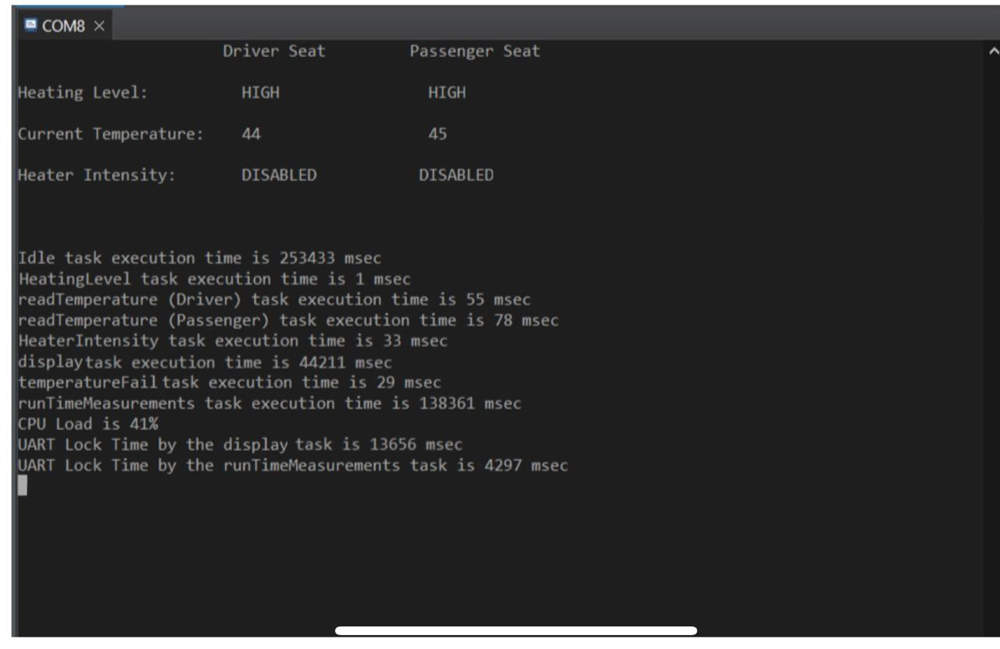
Output:

Slide 10
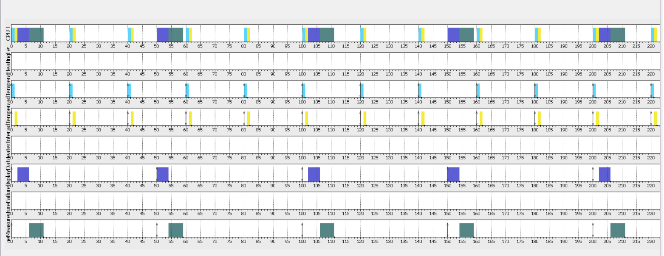
Simso Simulation:

